Slide 1
Bell Ringer 8/25/2016
Describe the site of Rich East High School
Describe the situation of Rich East High School
Student Leader:
Mr. Loux
To NOT lose your points, within 23 seconds after the bell you should:
Be SITTING in your assigned seat
Silent
Have your pink bell ringer sheet OUT
Be COMPLETING your bell ringer
FOR EXTRA CREDIT
Be prepared to comment

Slide 2
SWBAT…
Review site and situation, latitude and longitude, types of regions.
Create a representation of the four biomes

Slide 3
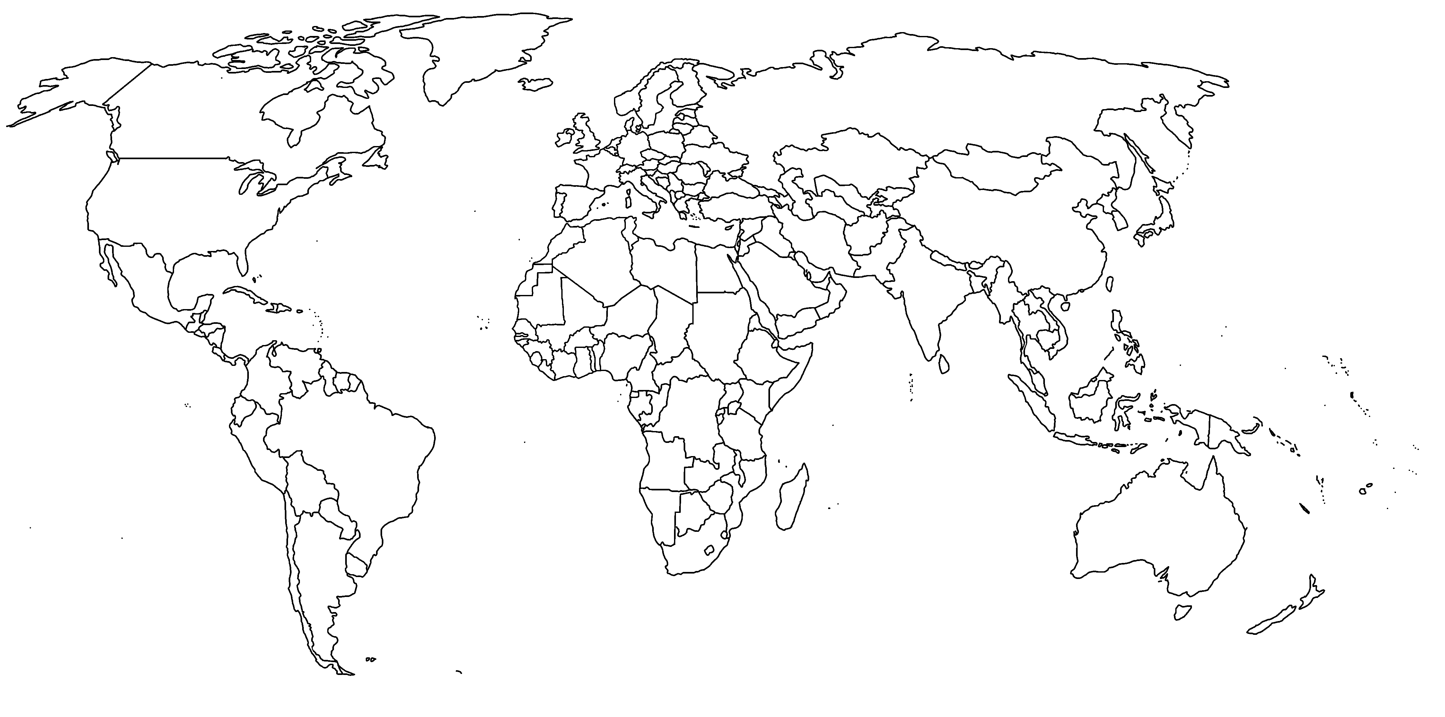
3
Europe
North America
Asia
Africa
South America
Australia
Antarctica

Slide 4
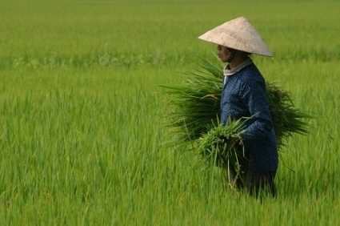
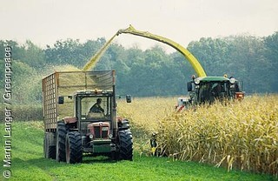
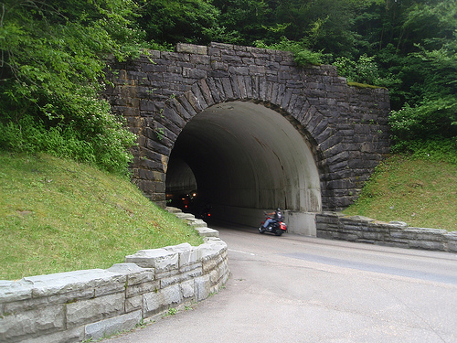
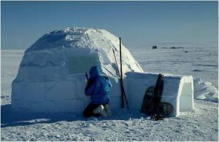
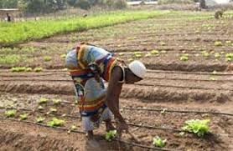
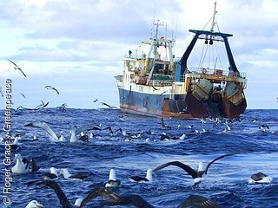
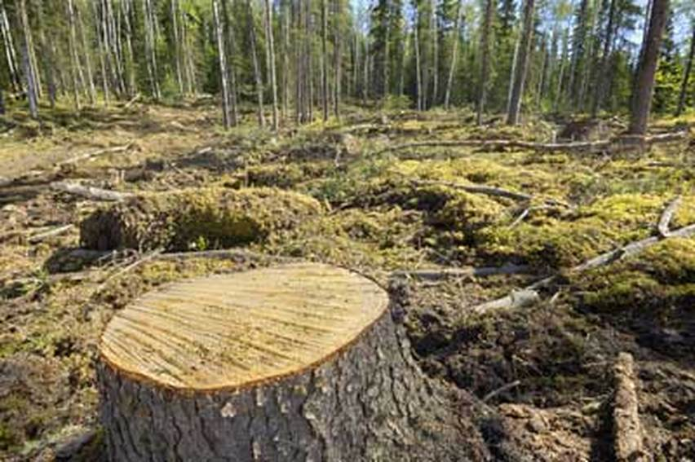
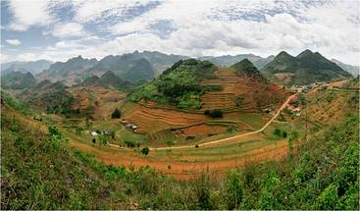
Cultural Ecology
Page 24

