Slide 1
Indo-European

Slide 2
Section A: What is Indo European?

Slide 3
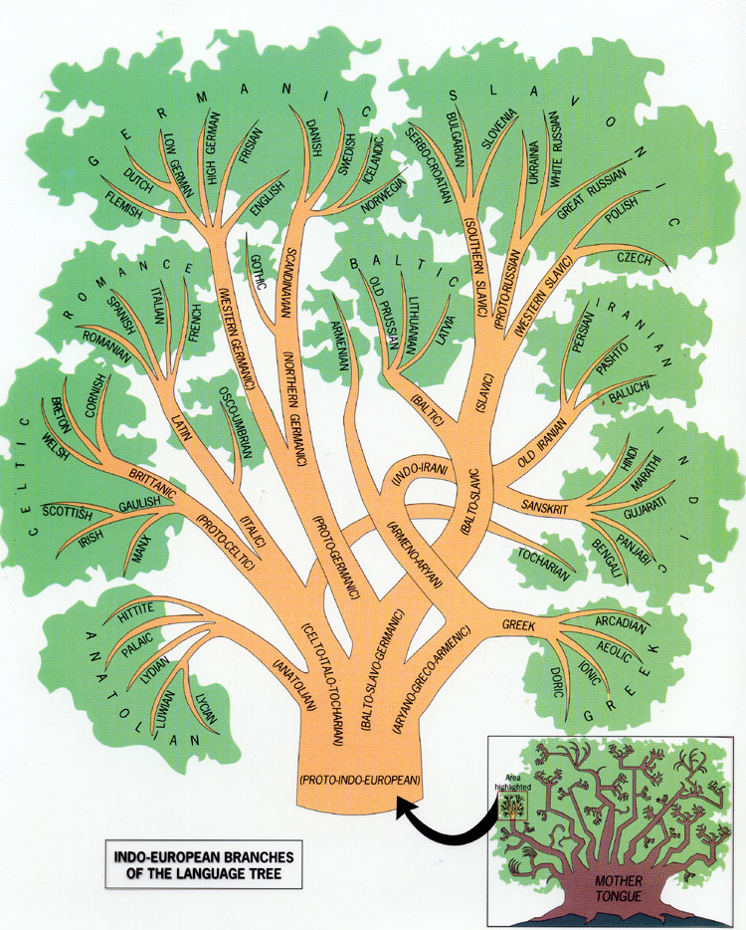
Indo-European is the language family spoken by 46% of the world’s population.

Slide 4
Where did Indo-European originate?

Slide 5
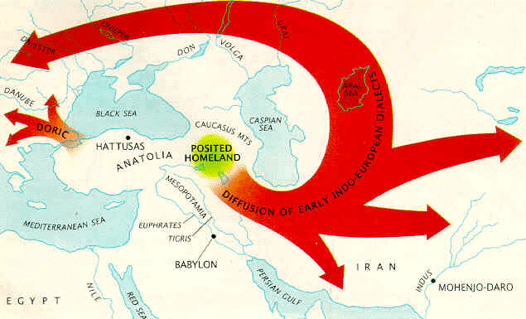
Sedentary Farmer Hypothesis
Sedentary Farmer Hypothesis
Developed by Colin Renfew
Also called the “Renfew Hypothesis”
Indo-European started in the Fertile Crescent.
Language diffused peacefully through agricultural trade.

Slide 6
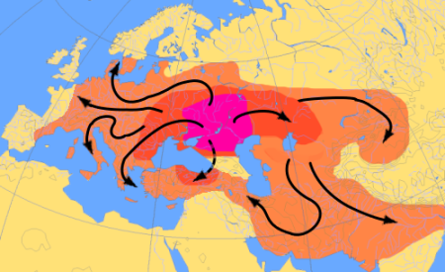
Kurgan Migration
Nomadic Warrior Thesis
Developed by Marinja Gimbutas
Also called the “Conquest Theory”
Indo-European began in the vicinity of Russia.
Kurgan Warriors brought the language with them as they conquered other areas.

Slide 7
Section B: The Indo-Iranian Branch

Slide 8
Indo-Iranian
Indic:
Iranian
Hindi
15 Others
Farsi
Pashto
Kurdish

Slide 9
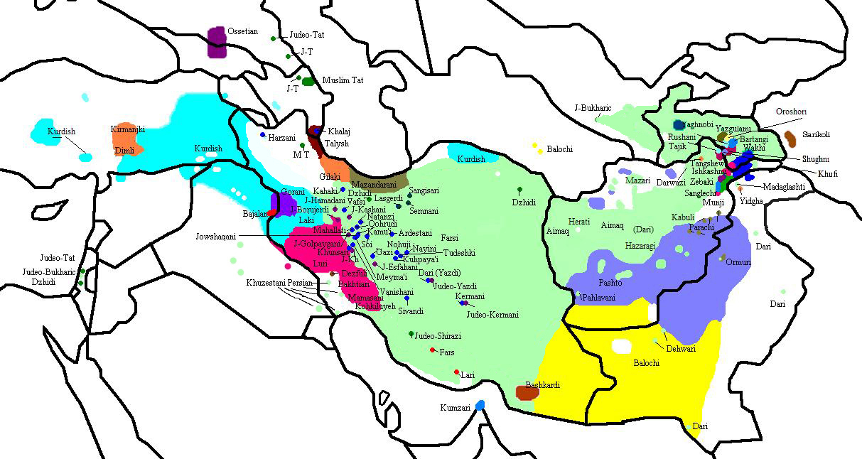
Green - Farsi
Purple – Pashto
Turquoise – Kurdish
Red – Lurish
Yellow - Baloch
The Iranian Languages

Slide 10
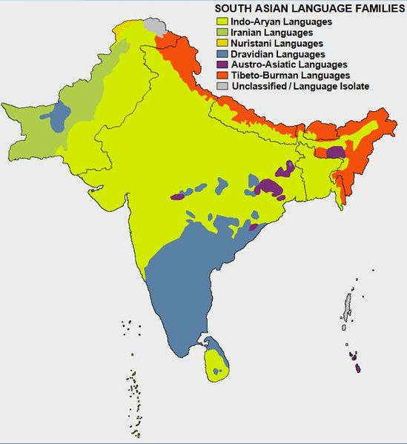
The Indian Languages

Slide 11
Hypothesize: Why would people in the same country speak so many different languages?

Slide 12
What is Linguistic Fragmentation?

Slide 13
Linguistic Fragmentation occurs when people in a country speak many different languages. This is often caused by physical or cultural barriers.

Slide 14
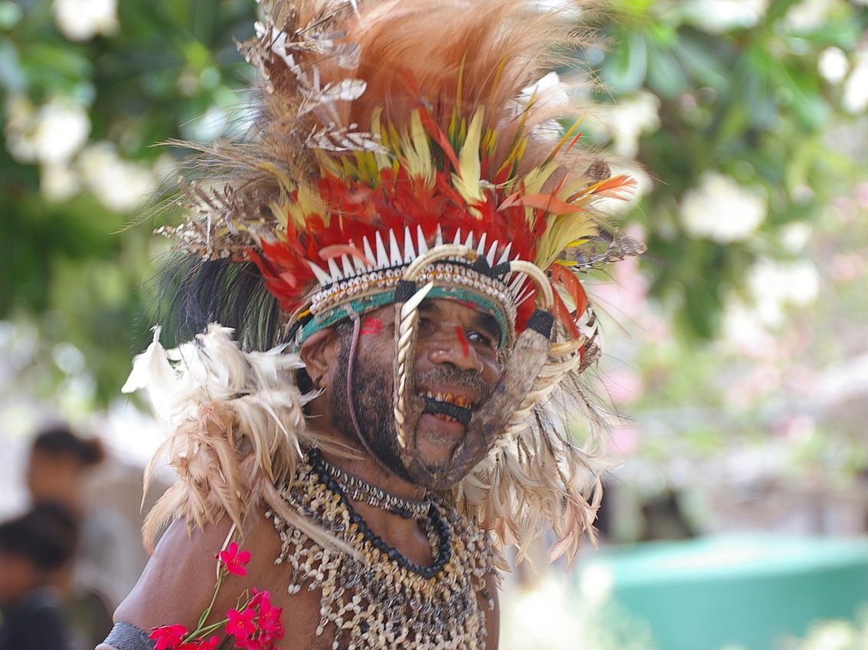
Papua, New Guinea has over 850 languages making it the most linguistically diverse place on earth.

Slide 15
Predict: How would people in a linguistically diverse country have a central government?

Slide 16
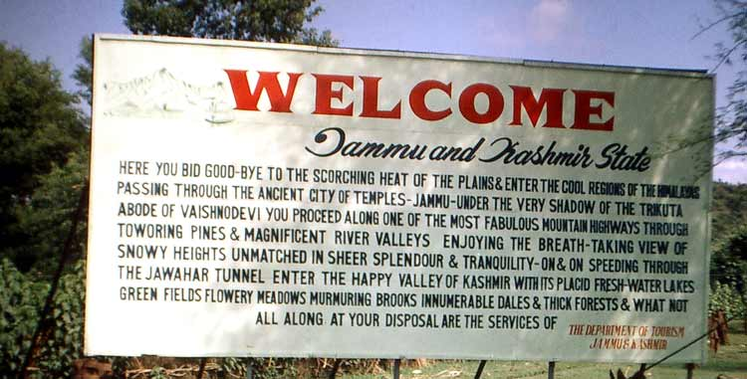
Many countries that experience linguistic fragmentation also have an official language. India’s official language is English.

Slide 17
What is an official language?

Slide 18
An official language is the language used by the government when making laws, reports, public objects, money, and stamps.

Slide 19
Why would India’s official language be English?
Notes:
Answer: Colonization by England

Slide 20
Example: New Zealand’s Official Language is only spoken by 5% of the Population
An official language is not always the majority language of an area.

Slide 21
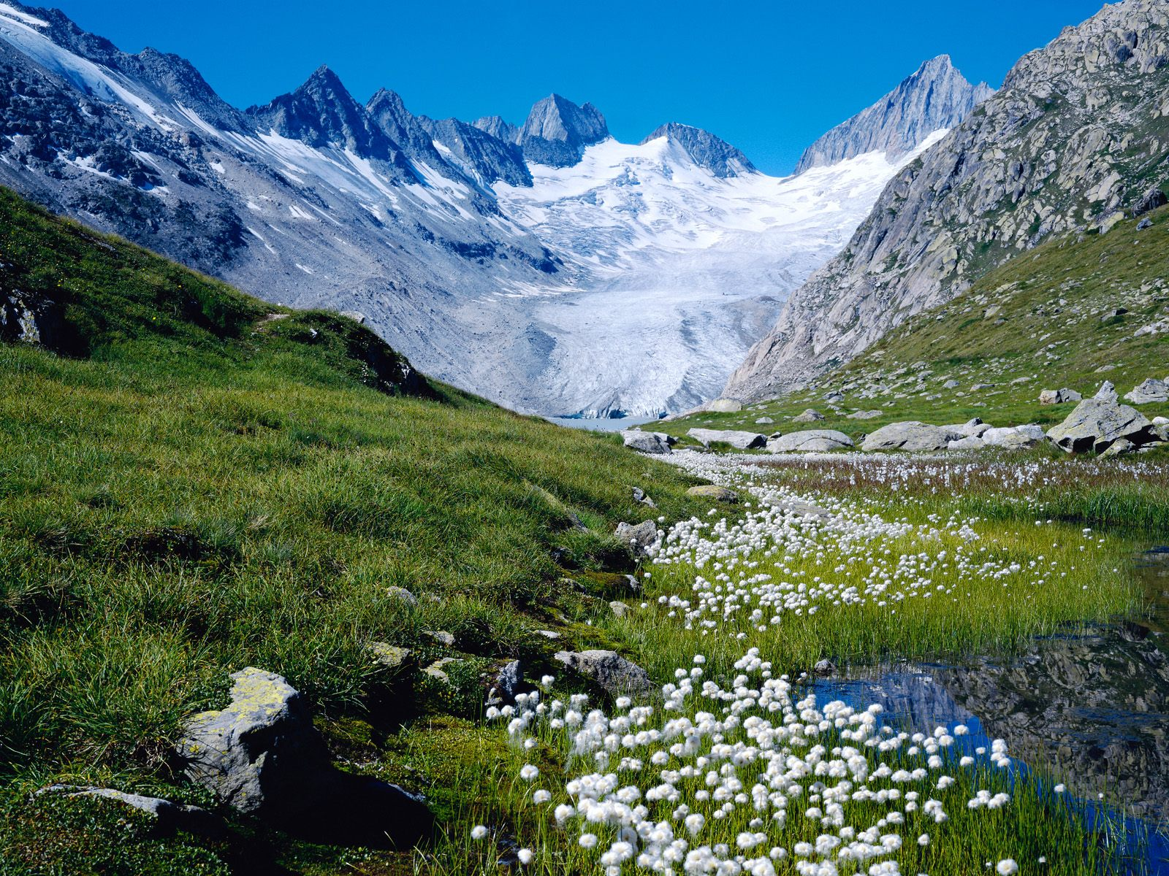
Example: Switzerland has Four: German, French, Italian, and Romansch
Some countries have more than one official language.

Slide 22
Section B: The European Branch

Slide 23
Romance Languages
Germanic Languages
Slavic Languages
French
English,
Russian
German,
Danish,
Norwegian
Swedish
Spanish
Italian
Romanian
Portuguese
Polish
Czech
Ukrainian
Slovenian
Serbo-Croatian

Slide 24
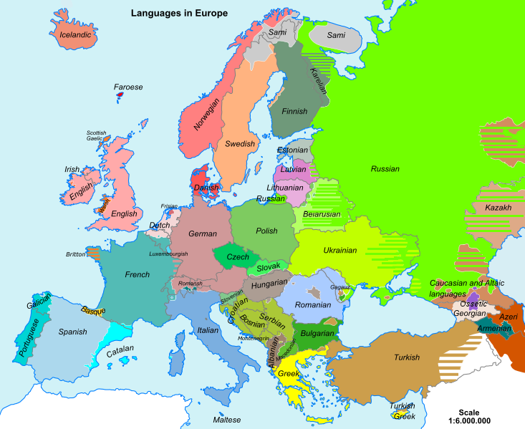
Basque is a language isolate.

Slide 25
What is a language isolate?

Slide 26
A language isolate is a language that is not related to any other language around it.
They are like a language family of only one language.

Slide 27
There are ____ ____world languages, in 90 years there will be ________ world languages. Why? What is happening? TED Talk A language dies every ____ days. ___________________________________________________________________________________________________ Other Notes:

